Slide 1
Measuring and comparing soil parameters for a large bridge on East coast of United States
Roger A. Failmezger, P.E., F. ASCE, D. GE
Southeastern Transportation Geotechnical Engineering Conference
Biloxi, Mississippi
November 9, 2016

Slide 2
Subsurface investigation
Performed CPT, DMT, PMT, VST, SPT and Seismic with True Interval (0.50 m) DMT Module
Discuss what techniques we used to more efficiently perform these tests
Compare the undrained shear strengths and deformation moduli from the tests
  Tests were performed in clusters at the north and south ends of the channel

Slide 3
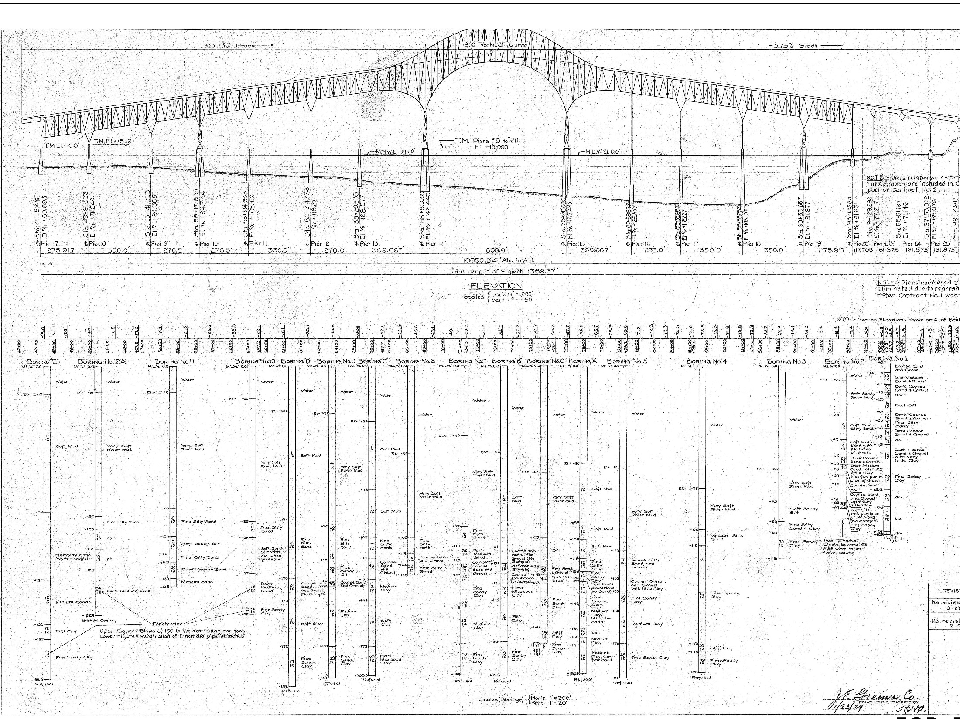
Subsurface Information from 1939

Slide 4
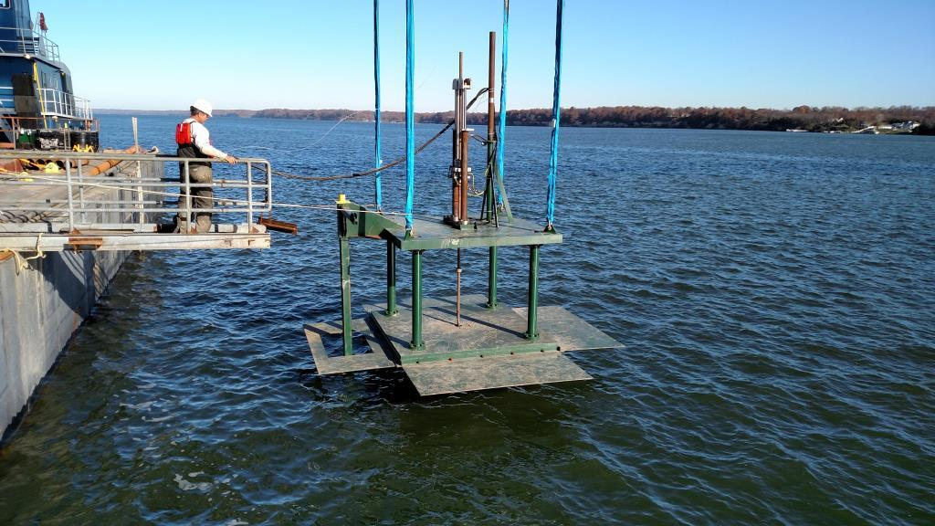
15-Ton capacity seafloor direct push system
Base Area = 192 sq. ft.

Slide 5
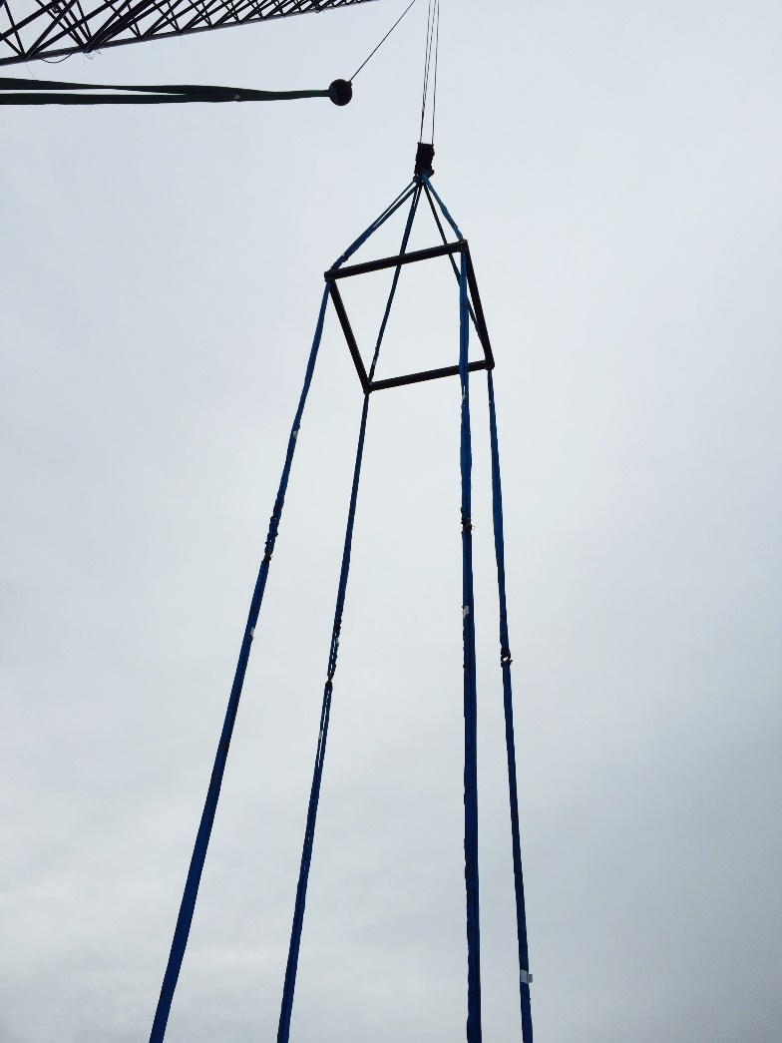
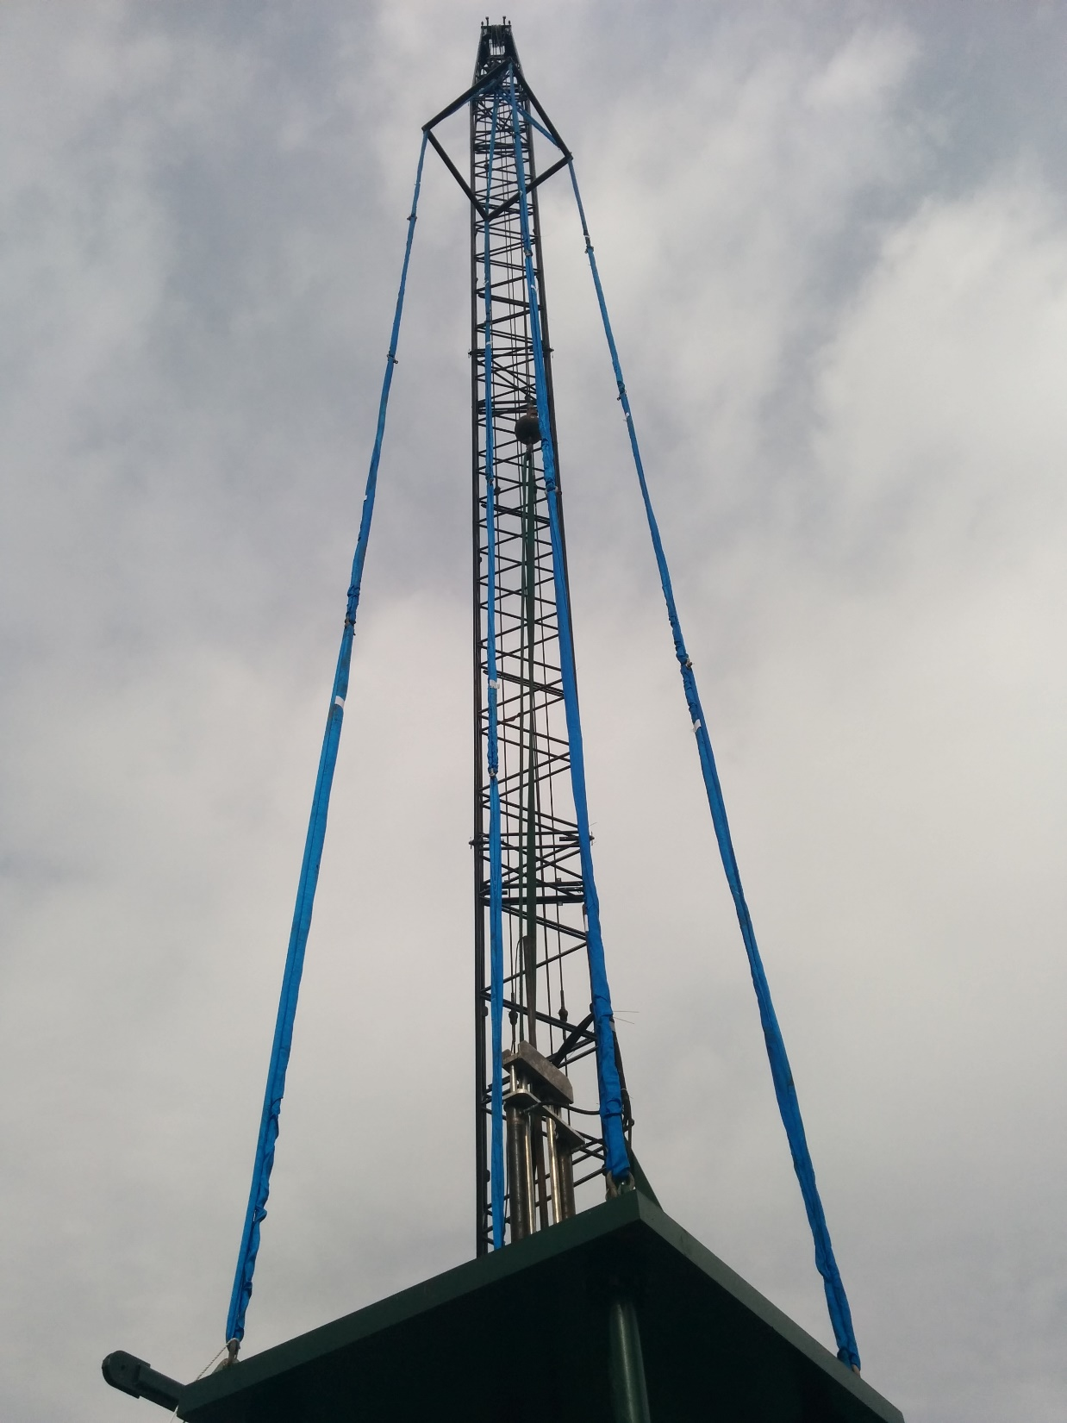
Using Spreader Frame to Keep Slings Vertical

Slide 6
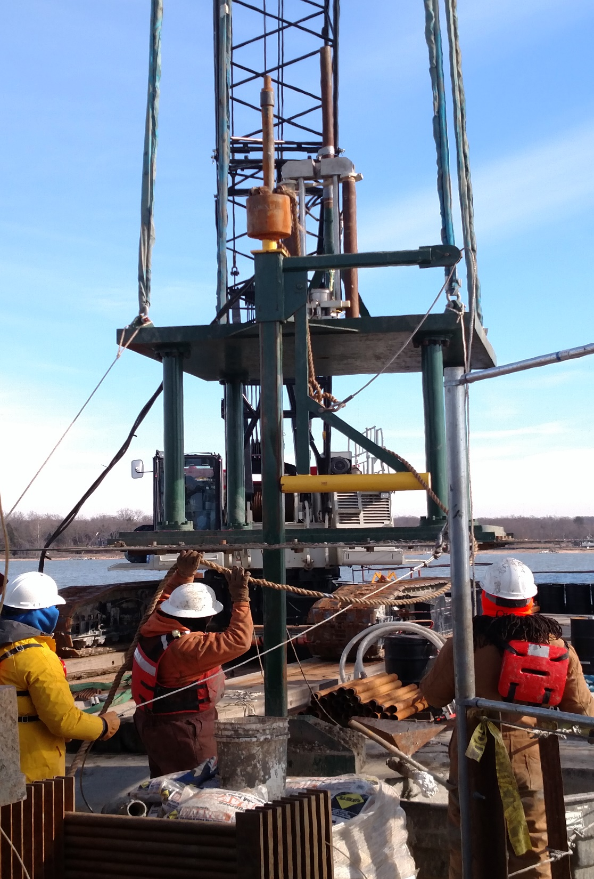
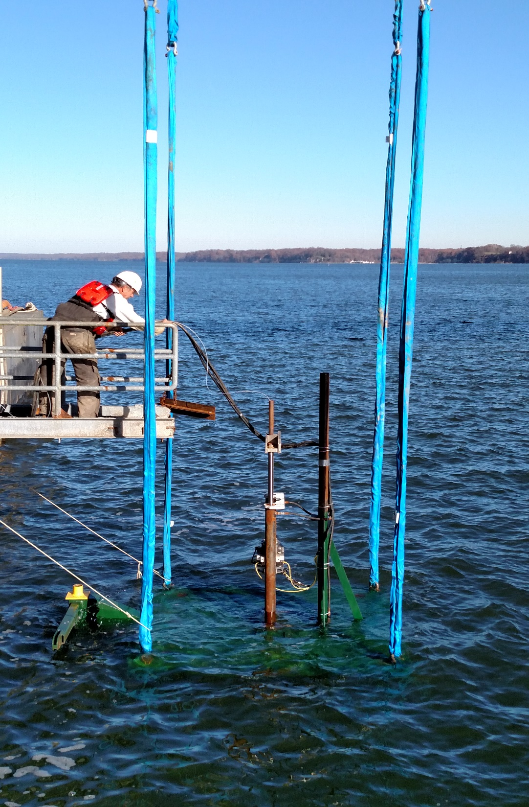
Seismic Hammer
Lowering Direct Push System

Slide 7
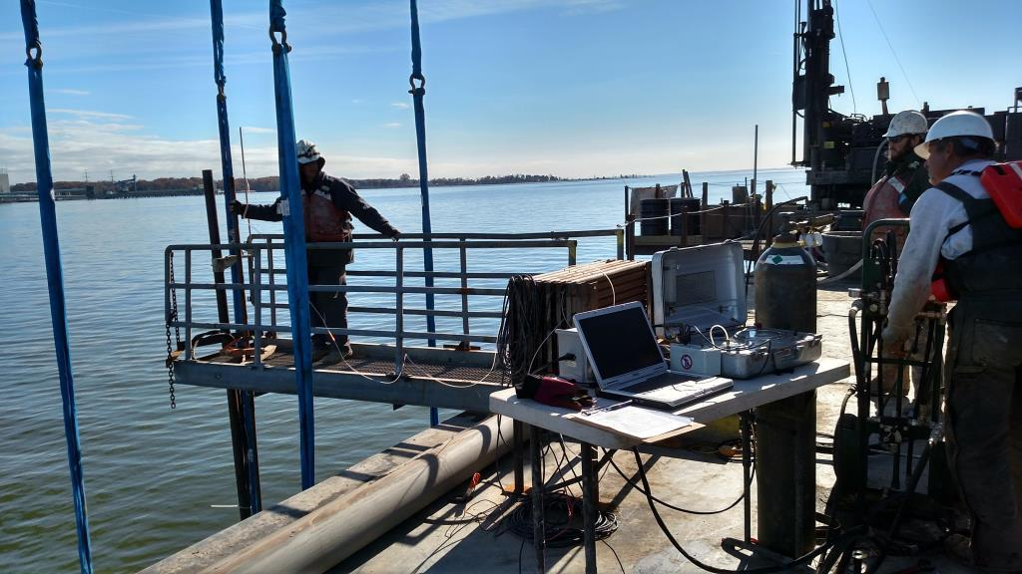
PERFORMING DILATOMETER USING SEAFLOOR SYSTEM

Slide 8
Advantages of seafloor direct push —Like pushing on land
Testing starts at the mudline
  measure the strength and deformation properties of very soft muds
3-inch casing attached to the top of the seafloor system and extended to the barge deck serves as fixed reference to measure the tests depths
  does not move with either waves or the tide and provides accurate measurements
  attached hydraulic and air hoses to casing
Rod pushing avoids zone between barge deck and mudline of parasitic rod buckling or lateral movement of casing
Probes are pushed at a constant 2 cm/sec rate
  Waves do not alter this rate or cause pinching of cables

Slide 9
P-Y analyses from Dilatometer sounding

Slide 10
vertical pile capacity from CPT sounding

Slide 11
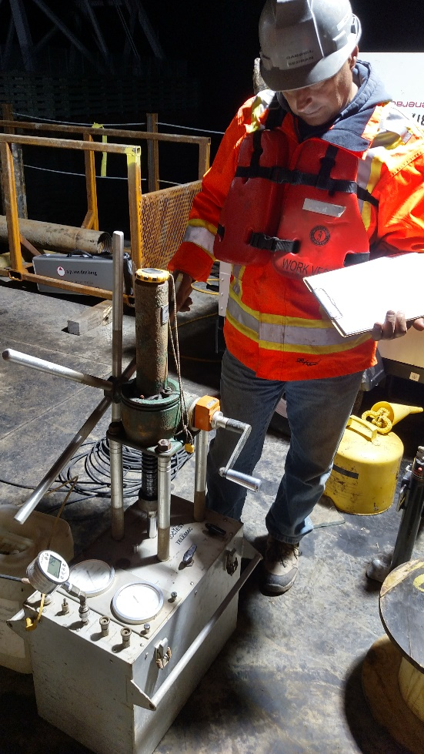
Pressuremeter tests
Used Texam Unit and performed strain controlled tests
  About 40 data measurements/test
Measured pressures with a digital gauge—accurate to 1 kPa
Used 74 mm tri-wing bit for cohesive soil and 76 mm tri-cone bit for cohesionless/cemented soil
  High quality borehole critical—experienced drillers important

Slide 13
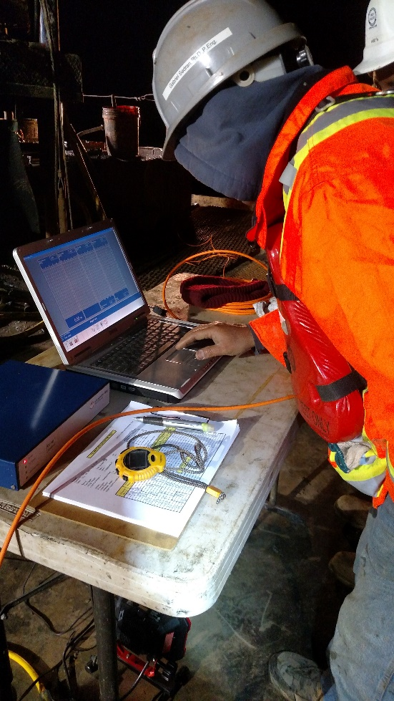
Vane shear tests
Used AP van den Berg I-VANE
Vane Motor at bottom of hole turned vane and measured torque
  No parasitic rod friction
Computer at surface read values from connecting cable and displayed results while performing test
Peak: turned vane 0.1º/sec for ¼ revolution
Rapid turning 6º/sec for 10 revolutions
Remolded: turned vane 0.1º/sec for ¼ revolution

Slide 14
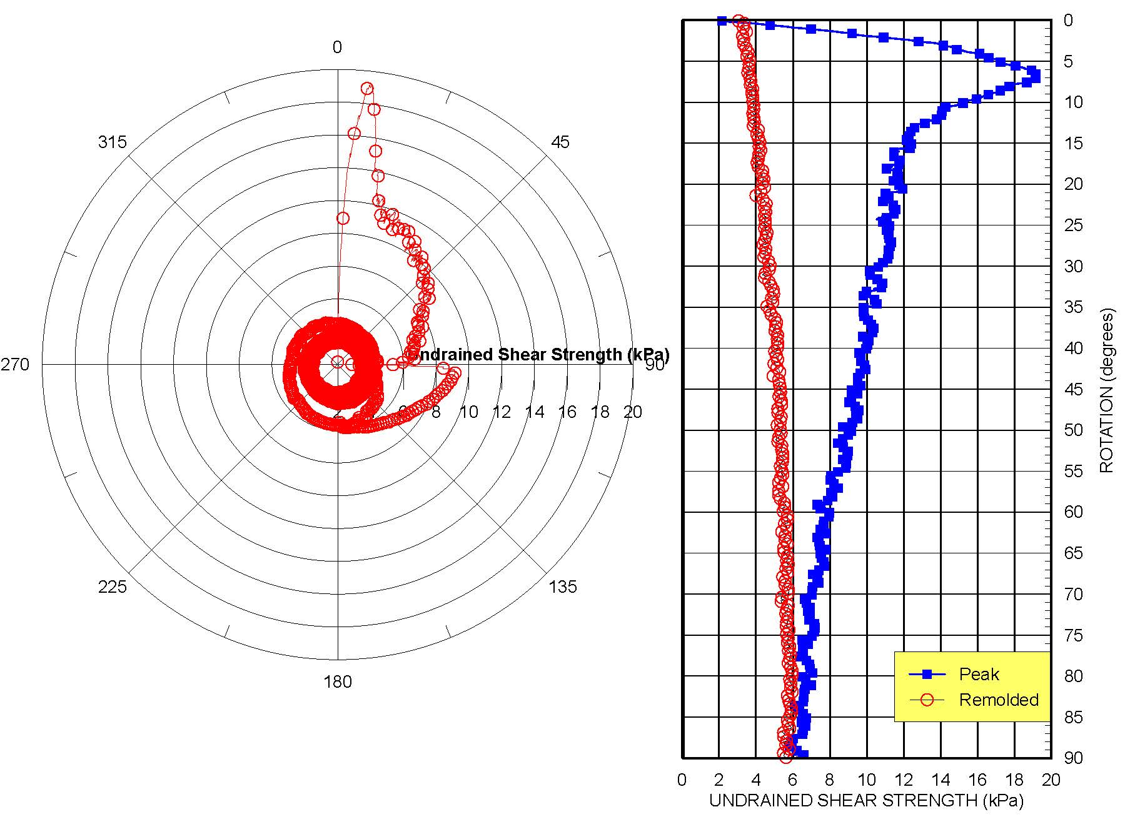

Slide 15
Standard penetration tests
Used 125 mm diameter steel casing telescoped inside 200 mm diameter steel casing
Added bentonite and polymers to the river water to make drilling mud—added soda ash to reduce the pH
Used NWJ drill rods (35 mm ID) for good mud circulation
Drill rods and Steel Casing were quite heavy for drill crew to maneuver
  Used crane on barge to either lower or remove them from hole
  Drilled lowered front jacks moving drill derrick out of way
  Crane could handle 110 feet (34 m) with each of its two hoists
Crane significantly improved efficiency of drilling/sampling operations

Slide 16
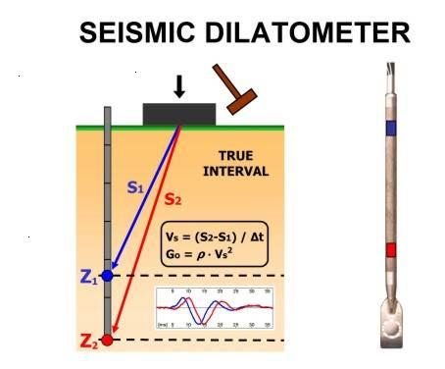
(After Marchetti, 2006)

Slide 17
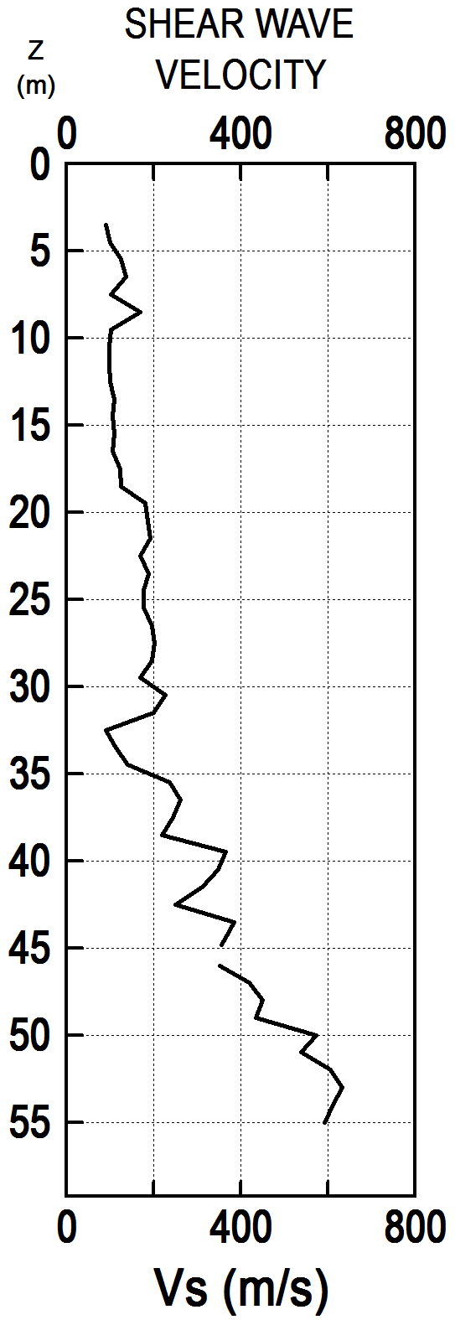
True interval Seismic tests
Contract required both compression and shear seismic tests to 55 meters below mudline
  Compression waves measured the speed through incompressible water (1500 m/s—wasteful)
Cemented layers prevented penetration from top to bottom
Drilled 125 mm hole to 56 m
Lowered SDMT probe to 55 m carefully aligning sensors
Backfilled with washed fine gravel about 5 m above test
Performed seismic tests (multiple strikes) and then raised probe 1 m for next test
Used large hammer from seafloor to generate waves

Slide 18
Enlarged scale for upper 15 meters
SOUTH END OF RIVER CHANNEL

Slide 19
SOUTH END OF RIVER CHANNEL

Slide 20
Enlarged scale for upper 15 meters
NORTH END OF RIVER CHANNEL

Slide 22
conclusions
Seafloor direct push system efficiently pushed DMT and CPT—like performing them on land—the way to go!
  Do not need costly jack-up barge
Successfully measured seismic waves with true-interval seismic DMT probe and seafloor hammer to 55 meters below mudline
Undrained shear strength and deformation modulus values compared favorably with DMT, PMT, VST and CPT with properly chosen correlation factors
Adjust the investigation as data are collected
  1939 data—inadequate—show sandstone instead of cemented sand layers
  Upper clays much softer than thought
  Lower soil much stiffer and stronger than thought—needed more pressuremeter tests
Ideally, investigations could include direct push sounding and soil boring adjacent to each other and performed simultaneously
  If direct push sounding has penetration refusal before desired depth, perform pressuremeter tests in boring to get high quality data in that missing in-situ test zone
  Best use of costly barge time

Slide 23
Thank You
Questions?

